Slide 1

Department of Computer Science
University Institute of Engineering
DEPARTMENT OF COMPUTER SCIENCE & ENGINEERING
Bachelor of Engineering
Subject Name: System Programming
Subject Code: CST-315
Compilers
DISCOVER . LEARN . EMPOWER

Slide 2
Chapter-2.1 Compilers
Department of computer Science
Introduction to various translators
Various phases of compiler

Slide 3
Assembler, Compilers and Interpreters
Any program that is not written in machine language has to be translated in machine language before it is executed by the computer.
The means used for translation are themselves computer programs.
There are three types of translator programs i.e. Assembler, Compilers and Interpreters.

Slide 4
Assembler
Assembler is a computer program which is used to translate program written in Assembly Language in to machine language.
The translated program is called as object program. Assembler checks each instruction for its correctness and generates diagnostic messages, if there are mistakes in the program
Various steps of assembling are:
Input source program in Assembly Language through an input device.
Use Assembler to produce object program in machine language.
Execute the program.

Slide 5
Compiler
A compiler is a program that translates a program written in HLL to executable machine language.
The process of transferring HLL source program in to object code is a lengthy and complex process as compared to assembling.
Compliers have diagnostic capabilities and prompt the programmer with appropriate error message while compiling a HLL program.
The corrections are to be incorporated in the program, whenever needed, and the program has to be recompiled.
The process is repeated until the program is mistake free and translated to an object code.

Slide 6
Features of Compiler
Following are the features of compiler:
To translate HLL source program to machine codes.
To trace variables in the program
To include linkage for subroutines.
To allocate memory for storage of program and variables.
To generate error messages, if there are errors in the program.

Slide 7
Compiler
compiler is a program that translates a source program (HLL; C, Java) into target code; machine re-locatable code or assembly code.
The generated machine code can be later executed many times against different data each time.
The code generated is not portable to other systems.

Slide 8
Interpreter
In an interpreted language, implementations execute instructions directly and freely without previously compiling a program into machine code instructions.
Translation occurs at the same time as the program is being executed.
An interpreter reads an executable source program written in HLL as well as data for this program, and it runs the program against the data to produce some results.

Slide 9
Interpreter
Common interpreters include Perl, Python, and Ruby interpreters, which execute Perl, Python, and Ruby code respectively.
Others include Unix shell interpreter, which runs operating system commands interactively.
Source program is interpreted every time it is executed (less efficient).

Slide 10
Interpreter
Interpreted languages are portable since they are not machine dependent. They can run on different operating systems and platforms.
They are translated on the spot and thus optimized for the system on which they’re being run.

Slide 11
Compilers and Interpreters
“Compilation”
Translation of a program written in a source language into a semantically equivalent program written in a target language
Input
Source
Program
Compiler
Target
Program
Error messages
Output

Slide 12
Compilers and Interpreters (cont’d)
“Interpretation”
Performing the operations implied by the source program
Source
Program
Interpreter
Output
Input
Error messages

Slide 13
Interpreter
The basic purpose of interpreter is same as that of complier. In compiler, the program is translated completely and directly executable version is generated whereas interpreter translates each instruction, executes it and then the next instruction is translated and this goes on until end of the program. In this case, object code is not stored and reused.
Every time the program is executed, the interpreter translates each instruction freshly.
It also has program diagnostic capabilities. However, it has some disadvantages as below:
Instructions repeated in program must be translated each time they are executed.
Because the source program is translated fresh every time it is used, it is slow process or execution takes more time. Approx. 20 times slower than complier.

Slide 14
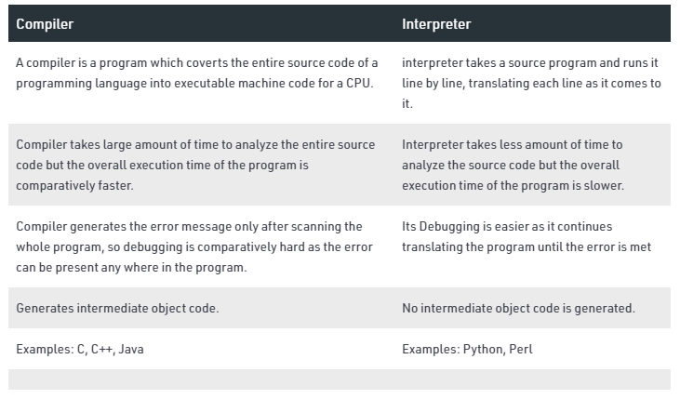
Compiler Vs Interpreter

Slide 15
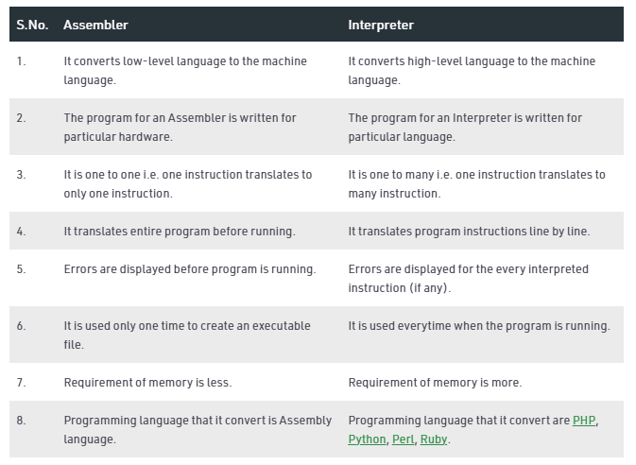
Assembler Vs Interpreter

Slide 16
The Analysis-Synthesis Model of Compilation
There are two parts to compilation:
Analysis Phase
This is also known as the front-end of the compiler. It reads the source program, divides it into core parts and then checks for lexical, grammar and syntax errors. The analysis phase generates an intermediate representation of the source program and symbol table, which should be fed to the Synthesis phase as input
Synthesis Phase
Its also known as the back-end of the compiler.
It generates the target program with the help of intermediate source code representation and symbol table.

Slide 17
Other Tools that Use the Analysis-Synthesis Model
Editors (syntax highlighting)
Pretty printers (e.g. Doxygen)
Static checkers (e.g. Lint and Splint)
Interpreters
Text formatters (e.g. TeX and LaTeX)
Silicon compilers (e.g. VHDL)
Query interpreters/compilers (Databases)

Slide 18
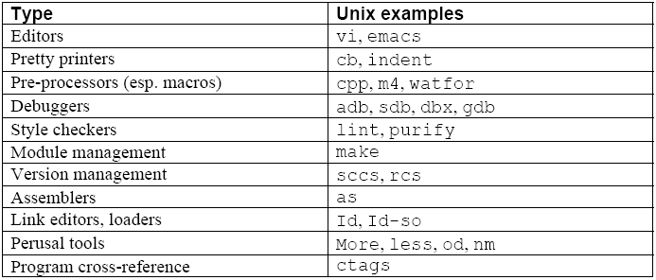

Programming Environment Tools
Tools

Slide 19
Preprocessors, Compilers, Assemblers and Linkers
A preprocessor considered as part of compiler, is a tool that produces input for compilers. It deals with macro-processing, file inclusion, language extension, etc.
Assembler
An assembler translates assembly language programs into machine code. The output of an assembler is called an object file, which contains a combination of machine instructions as well as the data required to place these instructions in memory.

Slide 20
Preprocessors, Compilers, Assemblers and Linkers
Linker
A computer program that links and merges various object files together in order to make an executable file.
All these files might have been compiled by separate assemblers. The major task of a linker is to search and locate referenced module/routines in a program and to determine the memory location where these codes will be loaded, making the program instruction to have absolute references.

Slide 21
Preprocessors, Compilers, Assemblers, and Linkers
Skeletal Source Program
Preprocessor
Source Program
Try for example:
gcc -v myprog.c
Compiler
Target Assembly Program
Assembler
Relocatable Object Code
Linker
Libraries and
Relocatable Object Files
Absolute Machine Code

Slide 22
Compiler Design - Architecture of a Compiler
A compiler can have many phases and passes.
Pass : A pass refers to the traversal of a compiler through the entire program.
Phase : A phase of a compiler is a distinguishable stage, which takes input from the previous stage, processes and yields output that can be used as input for the next stage. A pass can have more than one phase.

Slide 23
Phases of a Compiler
The compilation process is a sequence of various phases.
Each phase takes input from its previous stage and has its own representation of source program, and feeds its output to the next phase of the compiler.

Slide 24
Traditional three pass compiler
Source
code
Front end
IR
Middle
end
IR
Back end
Machine
code
errors

Slide 25
Phases of a Compiler - Front end
The front end analyzes the source code to build an internal representation of the program, called the intermediate representation (IR).
It also manages the symbol table, a data structure mapping each symbol in the source code to associated information such as location, type and scope.

Slide 26
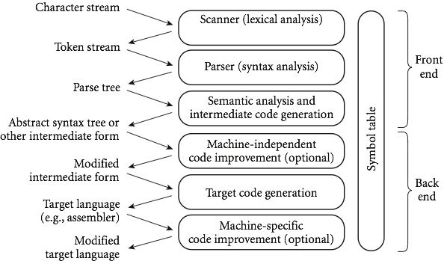
An Overview of Compilation
Phases of Compilation
Analysis Phase
Synthesis Phase

Slide 27
An Overview of Compilation
Phases of Compilation
Analysis Phase
Synthesis Phase

Slide 28
Phases of a Compiler - Front end cont’d
The front end includes all analysis phases and the intermediate code generator.
Lexical analysis is the first phase of compiler which is also termed as scanning.
During this phase, Source program is scanned to read the stream of characters and those characters are grouped to form a sequence called lexemes which produces token as output.
Tokens are defined by regular expressions which are understood by the lexical analyzer.

Slide 29
An Overview of Compilation
Lexical Analyzer – It reads the program and converts it into tokens. It converts a stream of lexemes into a stream of tokens. Tokens are defined by regular expressions which are understood by the lexical analyzer. It also removes white-spaces and comments.
Lexical Analysis (Scanning)
recognize regular language using DFA (deterministic finite automaton)
take input character stream
divide program into "tokens", smallest meaningful units to save
recognize identifiers, constants, keywords, operators
produce token stream
do simple tasks early to reduce complexity later

Slide 30
An Overview of Compilation
x = y + 10
Tokens
X identifier
= Assignment operator
Y identifier
+ Addition operator
10 Number

Slide 31
An Overview of Compilation
The languages accepted by some regular expression are referred to as Regular languages.
A regular expression can also be described as a sequence of pattern that defines a string.
Regular expressions are used to match character combinations in strings.
For instance:
In a regular expression, x* means zero or more occurrence of x. It can generate {empty, x, xx, xxx, xxxx, .....}
In a regular expression, x⁺ means one or more occurrence of x. It can generate {x, xx, xxx, xxxx, .....}

Slide 32
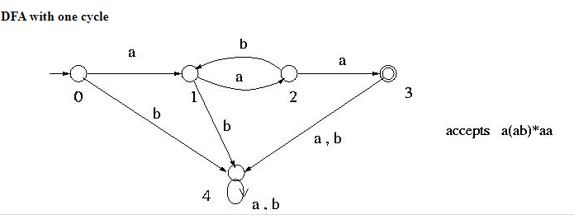
An Overview of Compilation

Slide 33
An Overview of Compilation
Phases of Compilation
Analysis Phase
Synthesis Phase

Slide 34
An Overview of Compilation
Syntax Analyzer – It is sometimes called as parser. It constructs the parse tree. It takes all the tokens one by one and uses to construct the parse tree.
Syntax Analysis (Parsing)
take token stream
output error messages
produce concrete syntax (parse) tree

Slide 35
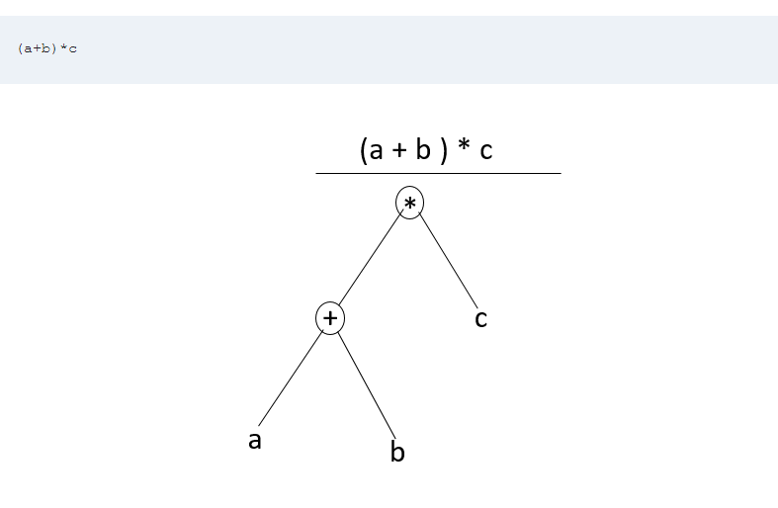
An Overview of Compilation

Slide 36
An Overview of Compilation
Phases of Compilation
Analysis Phase
Synthesis Phase

Slide 37
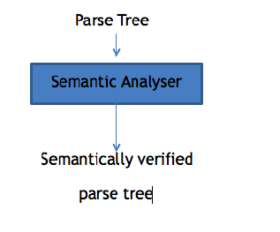
Phases of Compiler
Semantic Analyzer – It verifies the parse tree, whether it’s meaningful or not. It furthermore produces a verified parse tree.

Slide 38
An Overview of Compilation
Semantic analysis
recognize context-sensitive aspects of syntax
build symbol table
take concrete syntax (parse) tree
check type matches of variables and expressions
produce abstract syntax tree or some other intermediate form

Slide 39
An Overview of Compilation
Phases of Compilation
Analysis Phase
Synthesis Phase

Slide 40
Phases of Compiler
Intermediate Code Generator – It generates intermediate code, that is a form which can be readily executed by machine.
Intermediate code is converted to machine language using the last two phases which are platform dependent.
Till intermediate code, it is same for every compiler out there, but after that, it depends on the platform.
To build a new compiler we don’t need to build it from scratch. We can take the intermediate code from the already existing compiler and build the last two parts.

Slide 41
An Overview of Compilation
Intermediate form (IF)
produced if no errors in syntax or static “semantics”
chosen to balance machine independence, ease of optimization, ease of translation to final form, compactness
might use several intermediate forms
use abstract syntax trees and symbol table in our interpreters

Slide 42
Phases of Compiler
Code Optimizer – It transforms the code so that it consumes fewer resources and produces more speed.
Optimization can be categorized into two types: machine dependent and machine independent.

Slide 43
An Overview of Compilation
Phases of Compilation
Analysis Phase
Synthesis Phase

Slide 44
An Overview of Compilation
Machine-independent optimization
take intermediate-code program, optionally produce equivalent but “better” program – faster, smaller, etc.
produce another intermediate form program
examples: common subexpression elimination, dead code elimination, loop optimizations, in-line function calls, recursion optimization

Slide 45
An Overview of Compilation
Phases of Compilation
Analysis Phase
Synthesis Phase

Slide 46
Phases of Compiler
Target Code Generator – The main purpose of Target Code generator is to write a code that the machine can understand
This is the final stage of compilation.
Code generation
produce assembly language or relocatable machine language from intermediate form and symbol table
assign memory locations, registers, etc.

Slide 47
An Overview of Compilation
Phases of Compilation
Analysis Phase
Synthesis Phase

Slide 48
An Overview of Compilation
Machine-specific optimization
take output of code generation
Optionally improve using specific details of machine, e.g., special instructions, addressing modes, co-processors

Slide 49
An Overview of Compilation
Symbol Table – It is a data structure being used and maintained by the compiler, consists all the identifier’s name along with their types. It helps the compiler to function smoothly by finding the identifiers quickly.
Symbol table
track information about identifiers throughout all phases
support debugging, error recovery

Slide 50
The Phases of a Compiler
Phase | Output | Sample
Programmer (source code producer) | Source string | A=B+C;
Scanner (performs lexical analysis) | Token string | ‘A’, ‘=’, ‘B’, ‘+’, ‘C’, ‘;’ And symbol table with names
Parser (performs syntax analysis based on the grammar of the programming language) | Parse tree or abstract syntax tree | ; | = / \ A + / \ B C
Semantic analyzer (type checking, etc) | Annotated parse tree or abstract syntax tree
Intermediate code generator | Three-address code, quads, or RTL | int2fp B t1 + t1 C t2 := t2 A
Optimizer | Three-address code, quads, or RTL | int2fp B t1 + t1 #2.3 A
Code generator | Assembly code | MOVF #2.3,r1 ADDF2 r1,r2 MOVF r2,A
Peephole optimizer | Assembly code | ADDF2 #2.3,r2 MOVF r2,A

Slide 51
The Grouping of Phases
Compiler front and back ends:
Front end: analysis (machine independent)
Back end: synthesis (machine dependent)
Compiler passes:
A collection of phases is done only once (single pass) or multiple times (multi pass)
Single pass: usually requires everything to be defined before being used in source program
Multi pass: compiler may have to keep entire program representation in memory

Slide 52
Compiler-Construction Tools
Software development tools are available to implement one or more compiler phases
Scanner generators
Parser generators
Syntax-directed translation engines
Automatic code generators
Data-flow engines

Slide 53
References
Department of computer Science
[PDF] Systems Programming and Operating Systems by Dhamdhere - Free Download PDF (dlscrib.com)
[PDF] Principles of Compiler Design By Alfred V. Aho & J.D.Ullman Free Download – Learnengineering.in

Slide 54
THANK YOU

